Slide 1


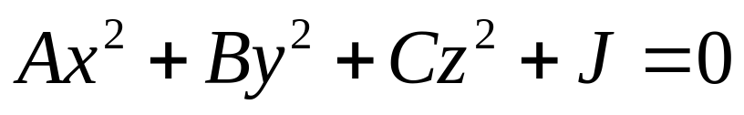
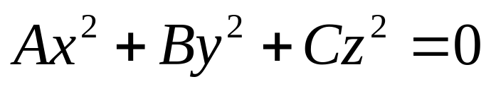
Quadric Surfaces (I)
A quadric surface is the graph of a second-degree equation in three variables and . The most general such equation is
By translation and rotation it can be brought into one of the two standard forms
or

Slide 2
Quadric Surfaces (II)
In order to sketch the graph of a quadric surface (or any surface), it is useful to determine the curves of intersection of the surface with planes parallel to the coordinate planes. These curves are called traces (or cross-sections) of the surface.

Slide 3
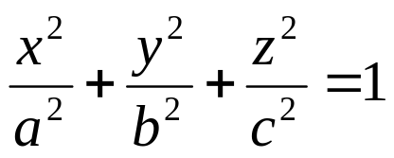


Ellipsoids
The quadric surface with equation is called an ellipsoid because its traces are ellipses. If two of the three semiaxes, and , are equal then the ellipsoid is a surface of revolution.

Slide 4
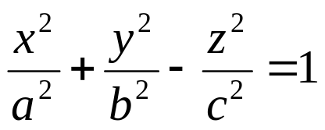

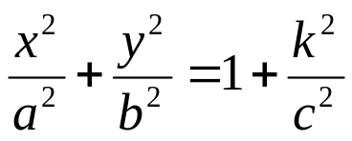

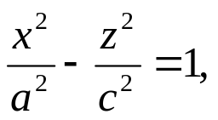
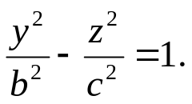




Hyperboloids (I)
The quadric surface with equation is called a hyperboloid because while the trace in any horizontal plane is the ellipse , but the traces in the and are the hyperbolas The is called the axis of this hyperboloid (if the minus sign occurs in front of the first or second term instead of the third term, then the axis is the or axis, respectively

Slide 5
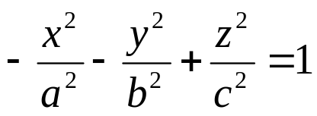


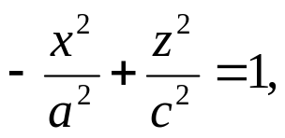
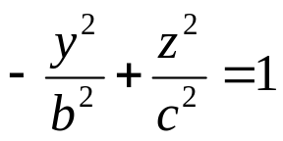

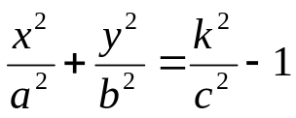
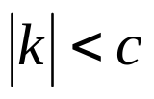



Hyperboloids (II)
With one minus sign the surface consists of one piece, it is called a hyperboloid of one sheet
,has traces in the and planes are the hyperbolas and . If the horizontal plane intersects the surface in the ellipse , whereas if , the plane does not intersect the surface at all. Thus the surface consists of two parts, one above the plane and one below the plane , and is called a hyperboloid of two sheets whose axis is the .

Slide 6
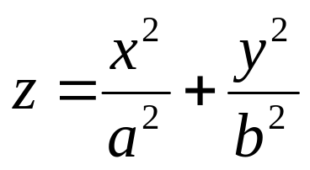
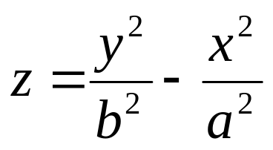
Elliptic and Hyperbolic Paraboloids
Elliptic Paraboloid
Hyperbolic Paraboloid

Slide 7





Translations and Reflections
When the coordinates are modified by substituting for , the geometric effect is to translate all points on the surface, so that point that was initially at (0,0,0) is moved to .
In xyz-coordinate system we get reflection about the xy-plane if is replaced by . That is replacing a variable by it negative causes the surface to be reflected about a coordinate plane. Interchanging two variables reflects the surface about a plane that makes a 45⁰ angle with two planes.

Slide 8


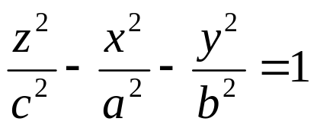
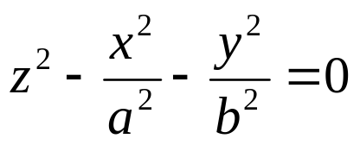
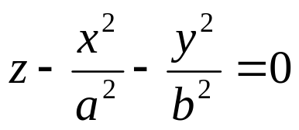
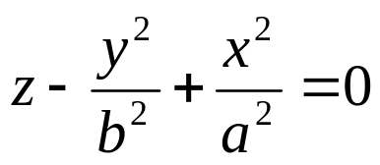
Identifying Quadric Surfaces
Equation Characteristic Classification
No minus signs Ellipsoid
One minus sign Hyperboloid of
one sheet
Two minus signs Hyperboloid of
two sheets
No linear terms Elliptic cone
One linear term;
two quadratic terms Elliptic paraboloid
with the same sign
One linear term;
two quadratic terms Hyperbolic paraboloid
with opposite signs

Slide 9



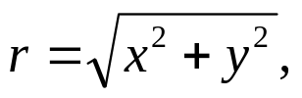




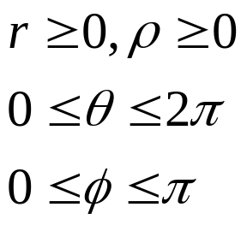




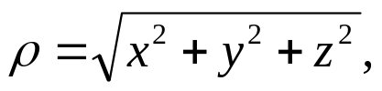
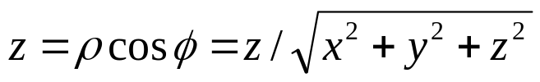
Converting Coordinates
Conversion Formulas Restrictions
Cylindrical to rectangular
Rectangular to cylindrical
Spherical to cylindrical
Cylindrical to Spherical
Spherical to rectangular
Rectangular to spherical

